Slide 1

Gold_finance_ETL: Automating Financial Data Pipelines
Welcome to our presentation on Gold_finance_ETL, a robust data engineering project that automates financial time series data processing. We'll explore how this pipeline transforms raw financial data into structured insights for business stakeholders and analysts.
Alpha Team
IN

Slide 2

Gold_finance_ETL: Automating Financial Data Pipelines
Alpha Team
IN
Mubarak Adeniran
(Team Worker)
Rofiyat Atoyebi-Tanimola
(Shaper)
Ifeanyi Nwosu
(Main Implementer)
Rita Uzoka
(Cordinator)
Ordi Obinna
(Team worker)
Francis Abude
(Team worker)
Oladimeji Oduye
(Implementer)

Slide 3

Overview: What is Gold_finance_ETL?
Automated ETL Pipeline
Advanced Technologies
Extracts, transforms, and loads financial data from Alpha Vantage API daily.
Utilizes PySpark, PostgreSQL, and Apache Airflow for efficient data processing.

Slide 4
Business Problem and Solution
Challenges
Gold_finance_ETL Solution
High volume of rapidly changing financial data
Fully automated workflows for daily data integration and analysis
Unstructured formats requiring significant cleaning
Time-intensive manual workflows prone to errors
Aggregated metrics for informed decision-making
Alpha

Slide 5




Data Source: Alpha Vantage API
Comprehensive Data
Provides daily prices and trading volumes for multiple financial symbols.
Daily Updates
Ensures accurate and timely data for trend analysis.
Industry Standard
Widely used and trusted in the financial industry.

Slide 6





Technologies Used
Apache Airflow
1
Orchestration and scheduling
PySpark
2
Data transformation at scale
PostgreSQL
3
Data storage and aggregation
Python & SQL
4
Core scripting and querying
WSL Docker (Optional)
5
Containerized deployments
Alpha

Slide 7
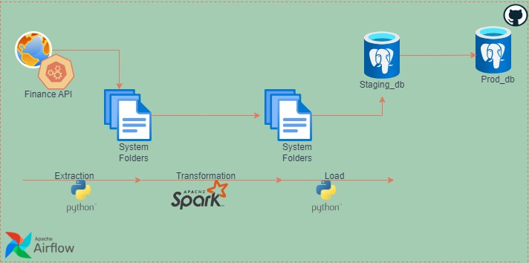
Solution Architecture
Alpha

Slide 8
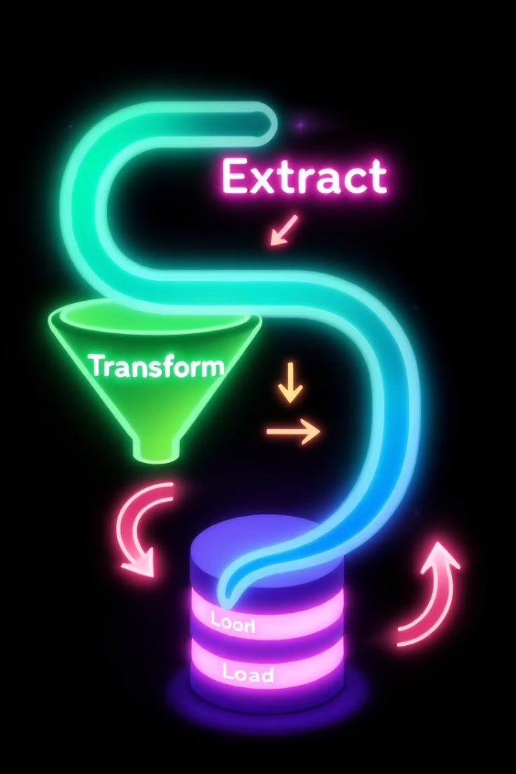




Pipeline Workflow
Extraction
Fetch data from Alpha Vantage API using extract.py module.
Transformation
Process raw JSON data into structured DataFrames using PySpark.
Loading
Insert data into PostgreSQL using incremental loading.
Aggregation
Generate insights using SQL procedures.

Slide 9
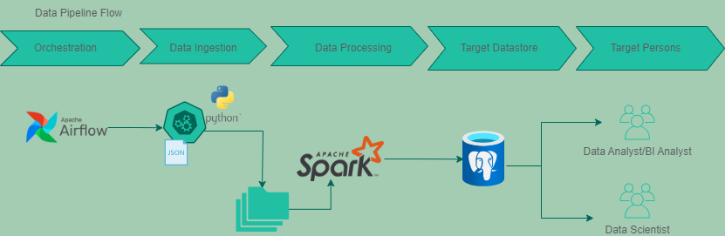
Pipeline Workflow
.

Slide 10
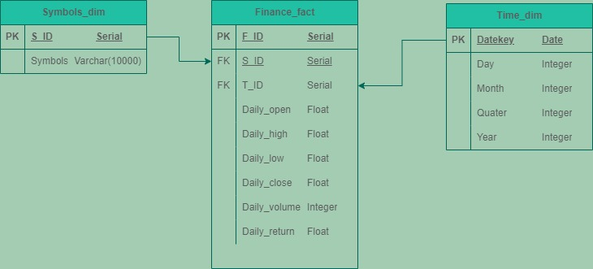
ERD
.

Slide 11

Data Quality Check
Missing values
Deduplication
Check for missing values in critical columns
Check for duplicate rows based on 'date' and 'symbol'
Invalid Ranges
Business Logic Validation
Check for invalid ranges (daily open, daily close
should be non-negative)
Business Logic Validation: daily close should be >= daily low
and <= daily high
Alpha

Slide 12
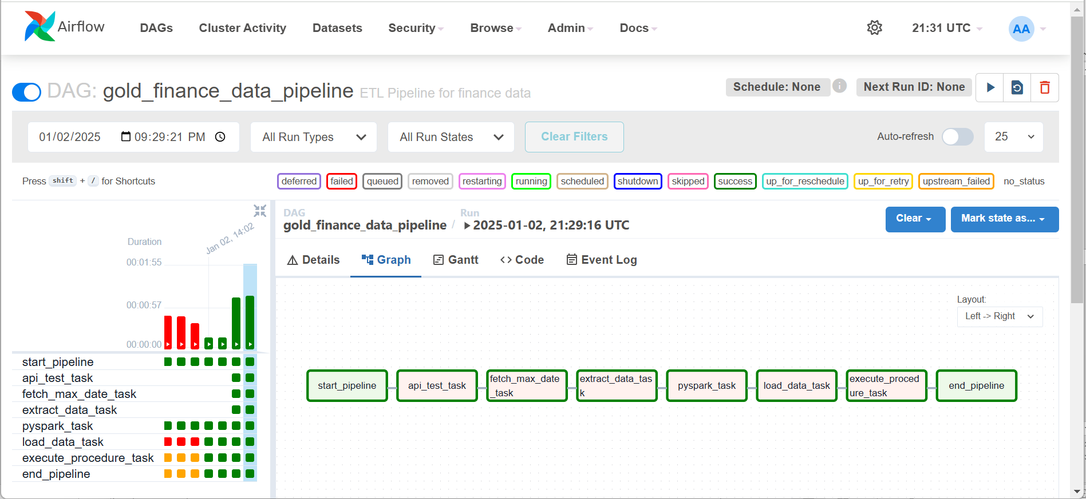
ETL Pipeline Orchestration
.

Slide 13
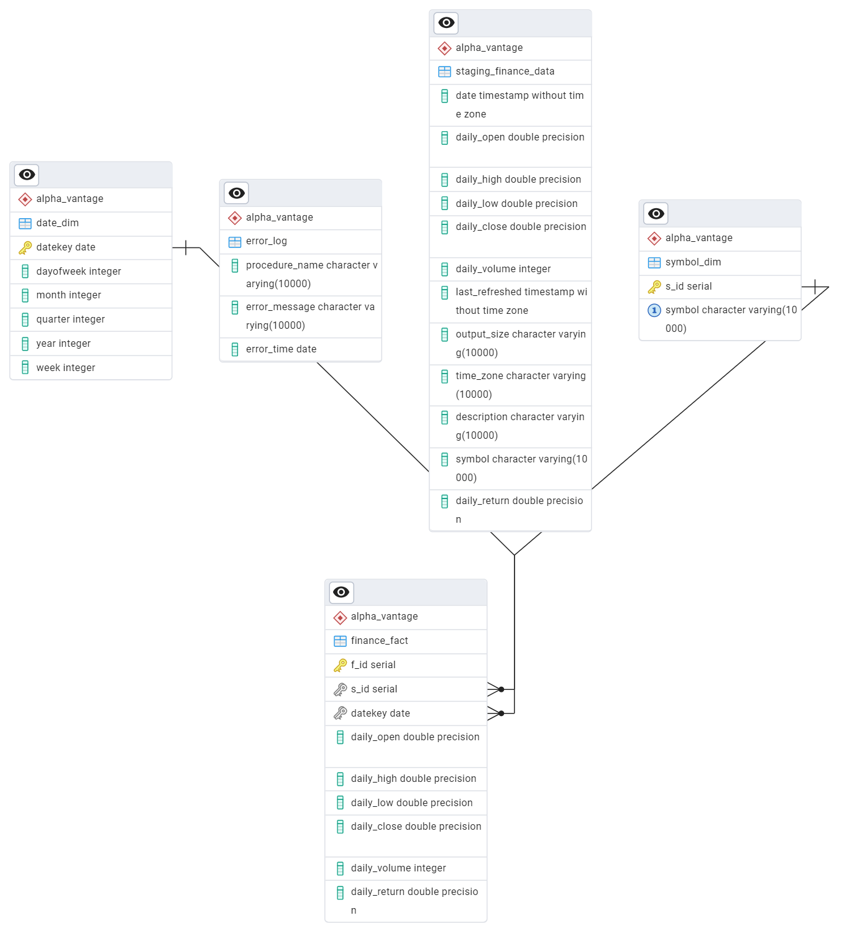
Data Warehouse
.

Slide 14
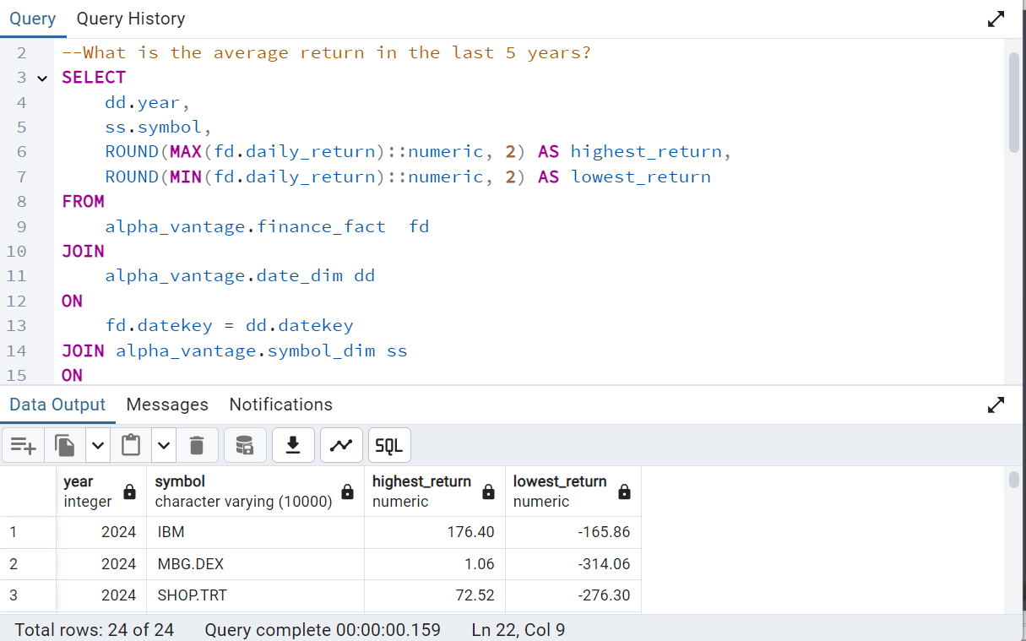
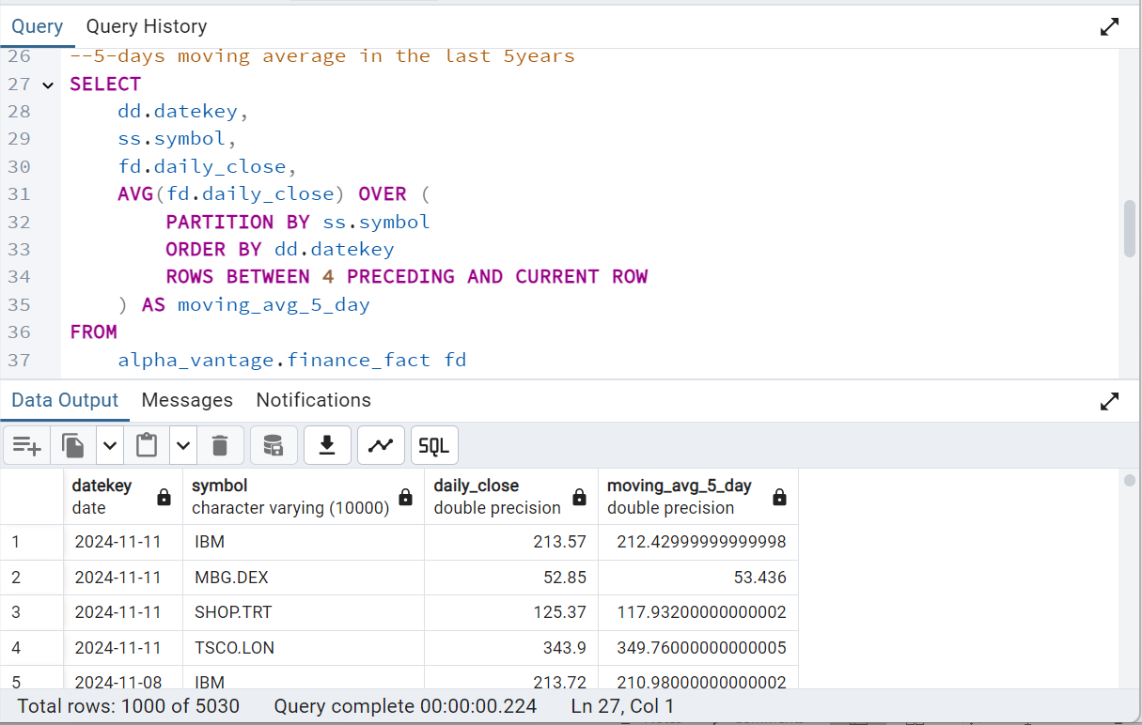
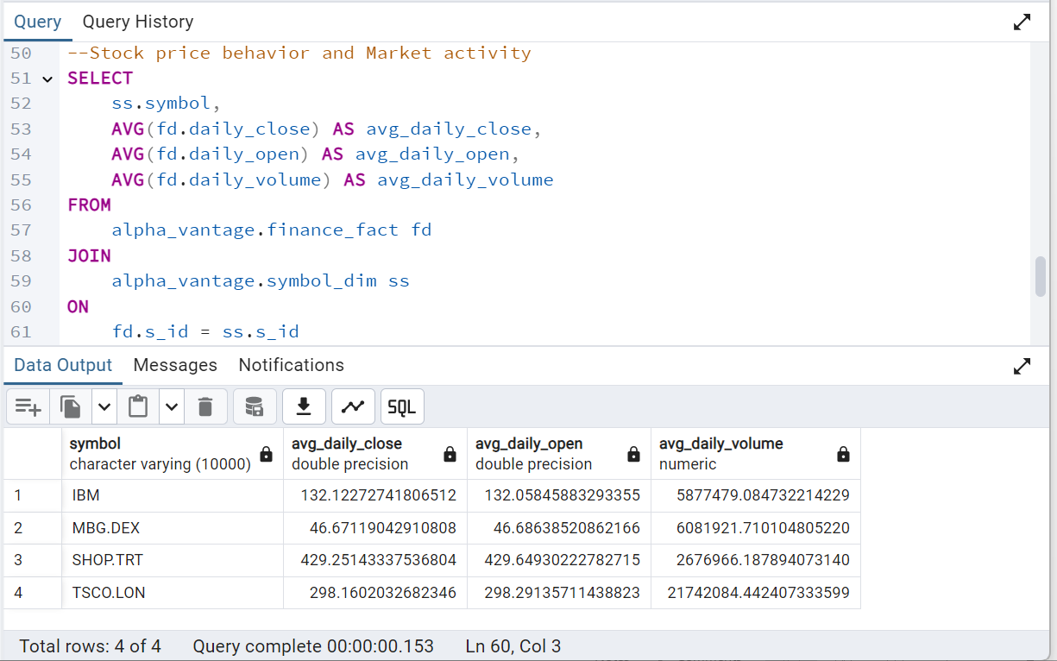
Data Analysis
.

Slide 15
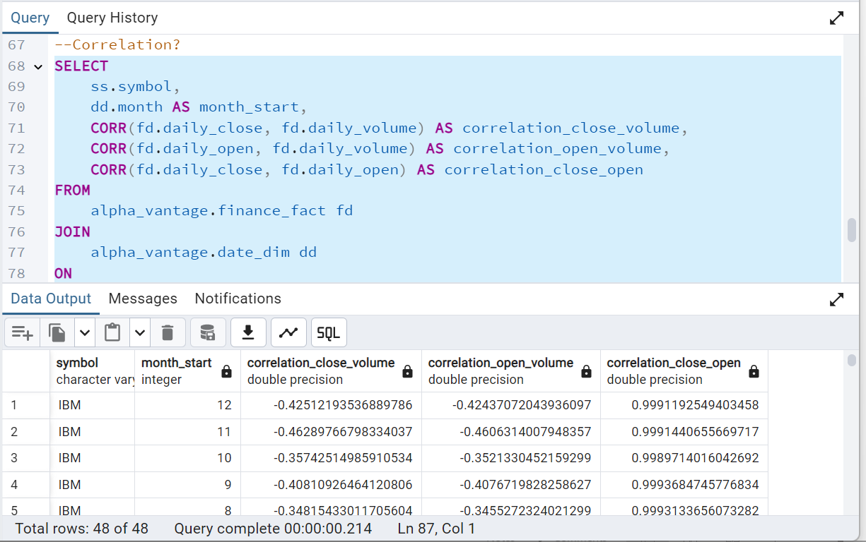
Data Scientist
.

Slide 16
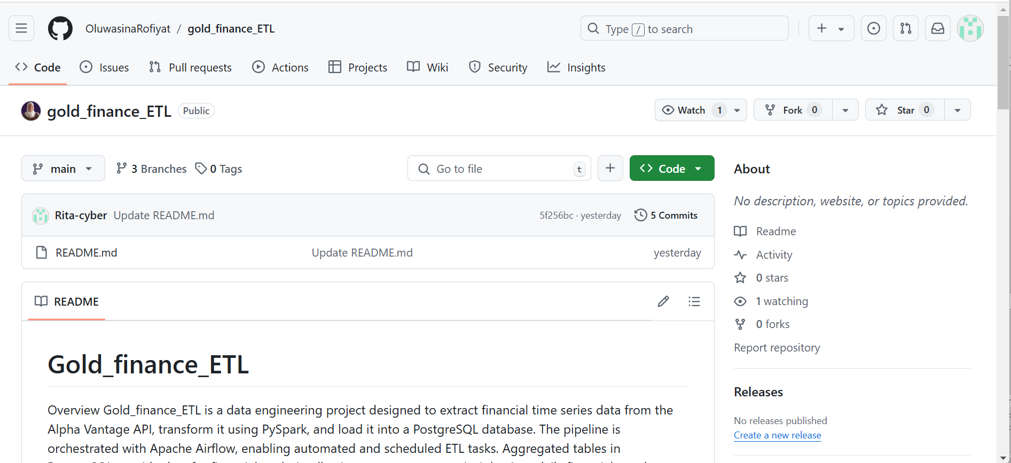
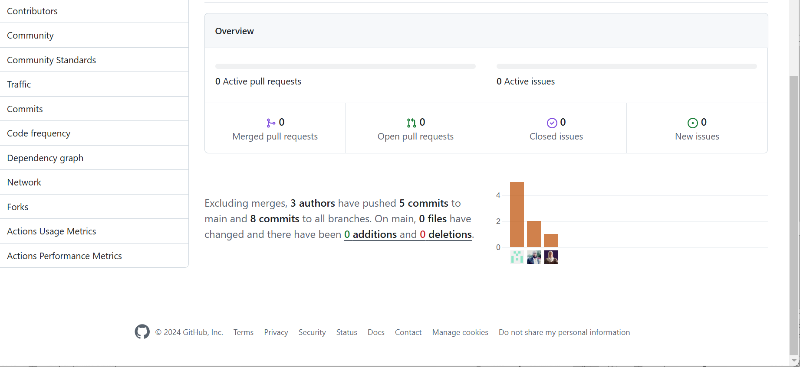
GitHub-Code Repository, Code Collaborators
.

Slide 17
Key Features and Benefits
Incremental Loading
Automated Orchestration
Optimizes resource usage by processing only new data daily.
Airflow DAG ensures seamless daily runs and failure recovery.
Scalable Design
Actionable Insights
Ready for future expansion and additional data sources.
Provides ready-to-use KPIs for data-driven decision-making.
Alpha

Slide 18
Problems encountered
Incremental Loading
Automated Orchestration
Added a python function to extract only daily data.
Airflow DAG logs and errors.
Parallel Processing
Challenge setting up on-prem Apache Spark, Jupiter notebook
and wsl desktop used.
Alpha

Slide 19

Results
1
Optimized data Query by 20%
Implemented Indexing in the Data Warehouse.
2
Optimized data processing by 10%
Apache Spark used for parallel processing
3
Performance Efficiency and Scalability
Modularized code
4
Timely data pipeline deployment
Orchestration and scheduling.
Cost Optimization
Alpha

Slide 20
Recommendations
1
Partitioning in the data warehouse
2
Spark Optimization
Liquid Clustering, Bucketing
3
Data Life cycle process
Alpha

Slide 21
Future Enhancements
1
Dashboard Integration
Connect PostgreSQL to BI tools like Tableau or Power BI.
2
Real-Time Processing
Incorporate for cloud platforms like Databricks, aws kinesis for streaming data ingestion.
3
Additional Data Sources
Expand to other APIs for broader analysis.
4
Machine Learning/Generative AI
Predict trends using historical data.
Alpha

Slide 22
THANK YOU
Alpha Team
IN

